Slide 1
2025 FCE MIDYEAR
Monday February 10
ZOOM

Slide 2
National FCE Headquarters
73 Cavalier Suite 106
Florence, KY 41404
All Forms due April 15 unless noted otherwise
Notes:
This address is good till April 30, 2025 then National Headquarters will have a post office box.

Slide 3
NATIONAL FCE Creed
We will strive to promote a better way of life for all through fellowship, continuing education and service;
To provide guidance in our homes and communities by the uniting of people to make the world a better place in which to live;
May we have pride in our role as homemakers and family and community educators and may our hearts be filled with joy as we serve.
Let us always be conscious of the needs of others and be strengthened by the “Divine Light” that guides us all. Jean Beard Kestner
ean

Slide 4
NATIONAL FCE MISSION
The Mission of the
National Association for Family and Community Education
  Is strengthening individuals, families and communities through
  CONTINUING EDUCATION
  DEVELOPING LEADERSHIP and
  COMMUNITY ACTION

Slide 5
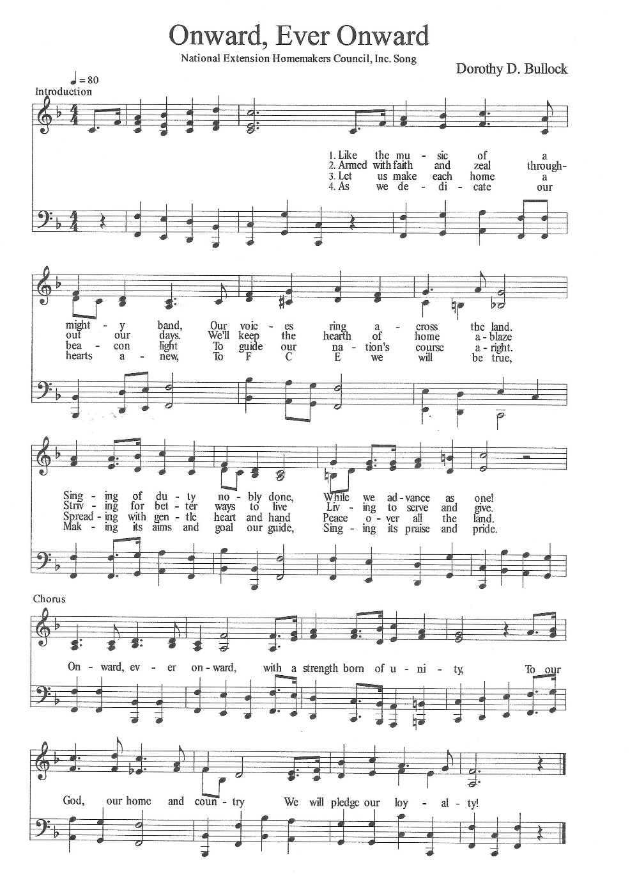
NATIONAL FCE MUSIC & WORDS
Notes:
The National FCE Song ~ Onward, Ever Onward ~ we had this professionally printed with the 4 verses just recently.

Slide 6
NATIONAL FCE TRADEMARKS
FCE Name
FCE Logo
FCE Emblem
FCE Seal
FCL Logo
FCE Today
FCE FLASH
FCE Friends
Family ChoicE TV ~ Family ChoicE Media
Professor Media
Vision Logo
Food Security Logo
Notes:
This is a list of the trademarked items that FCE keeps current.

Slide 7
National Association for Family and Community Education
The name of the organization is trademarked. The organization was incorporated May 5, 1975 in Raleigh, North Carolina. FCE is a non-profit charitable 501 © 3 organization as defined under the Internal Revenue Code.

Slide 8


FCE Logo
Notes:
The FCE logo is the acronym for “Family and Community Education”. The logo should be used on stationery and envelopes. It should be kept clean and free of clutter, so it can be easily recognized. The logo includes FCE as well as the words. The logo should not be used within state outlines. The name of the state may be used in the place of national . The FCE Logo in color and black and white. The official color is Printer’s Media Standard – 308 Blue.

Slide 9

FCE Emblem
Notes:
The emblem may be used for club program books, brochures or on FCE Educational material.

Slide 10

FCE SEAL
Notes:
The FCE Seal is used for formal items such as certificate of honor or achievement.

Slide 11
FCL Logo
Notes:
The FCL logo is used for FCL items. Symbol s Printer’s Media Standard 355, words Printer’s Media Standard 5286.

Slide 12


FCE Today
Notes:
The FCE TODAY is an official trademark of the newsletter publication for the National FCE organization.

Slide 13

This is not copyrighted
FCE FLASH
Notes:
The FLASH is used for 1 or a most 2 items to get them out quickly to our membership via email.

Slide 14
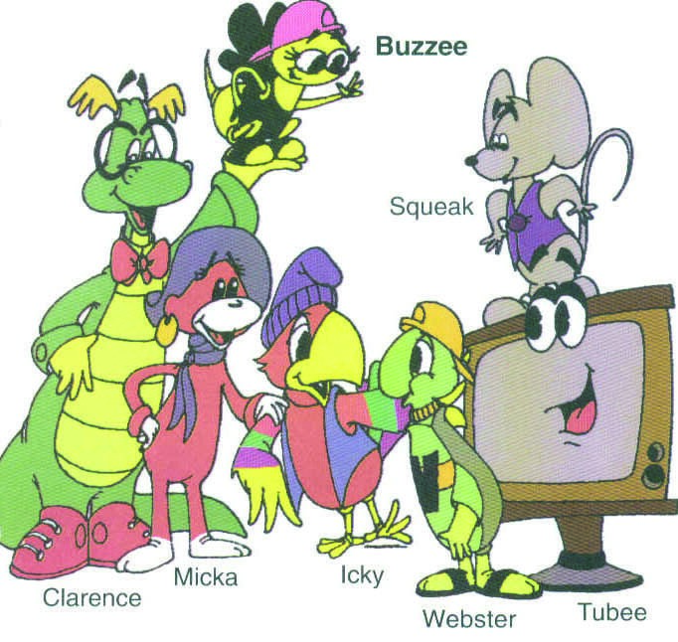
FCE Friends
Notes:
The FCE Friends logo is used on the story books. The friends are characters to be used in FCE programs and promotions.

Slide 15

FCE Family ChoicE-TV
FCE Family ChoicE Media
Notes:
FCE Famliy ChoicE-TV was trademarked for Tune Out Violence and to promote the Chldren and Television project. It may be used on t-shirts, banners, balloons and flyers. FCE has not made a mark for the FCE Family ChoicE-Media campaign.

Slide 16
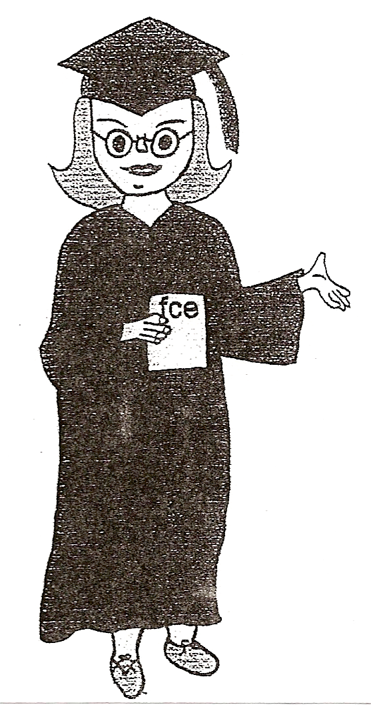
FCE Professor Media
Notes:
Professor Media was designed and drawn by Bettie Lucas and can be used on Media or other Public Policy issues that relate to Media. Professor Media is the copyrighted mascot for the Family ChoicE-Media, Tune into Family project introduced in 2006.

Slide 17

FCE Vision Logo
Notes:
This was adopted at the 2024 Conference ~ our Vision Logo ~~ Home Family Community

Slide 18

FCE Food Security Banner
Notes:
This Banner was developed to go with our Food Security project.

Slide 19
NATIONAL FCE LICENSE APPLICATION FORM
LICENSE AGREEMENT FOR USE OF TRADE/SERVICE MARKS OF THE NATIONAL ASSOCIATION FOR FAMILY AND COMMUNITY EDUCATION This License Agreement is made effective as of the _____day of ________, in the year _____, by and between the NATIONAL ASSOCIATION FOR FAMILY AND COMMUNITY EDUCATION, a non-profit corporation organized and existing under the laws of the state of North Carolina, whose mailing address is 73 Cavalier Blvd., Suite 106, Florence, KY 41042 (hereinafter referred to as “LICENSOR” or “National FCE”) and ___________________________________________ an affiliate of National FCE, whose mailing address is ____________________________ (hereinafter referred to as “LICENSEE” ) for the purpose of granting certain license rights to LICENSEE subject to the terms and conditions set forth herein. LICENSOR is the owner of trademarks, service marks and copyrights (hereinafter called “marks” or “rights”) and registrations thereof named and described below: The FCE logo ____ ___________ The FCL logo_____________________ The FCE Seal________________ FCE Friends _____________________ Family ChoicE-TV_______________ Professor Media ___________________ Family ChoicE-Media____________ (Check those desired to be licensed to LICENSEE) LICENSOR and LICENSEE desire to allow LICENSEE to have the right to make use of the Marks/Rights in its business to the extent that the Marks/Rights are used solely for the purposes of carrying out the ideals, goals and programs of LICENSOR and in consideration of LICENSEE’S position as an affiliate of National FCE and LICENSEE’s commitment to promote the ideals, goals and programs of LICENSOR, this License Agreement is made. LICENSEE acknowledges the ownership of the Marks/Rights of LICENSOR, agrees that it will do nothing inconsistent with such ownership and that all use of the Marks/Rights by LICENSEE shall inure to the benefit and be on behalf of LICENSOR, and agrees to assist LICENSOR in recording this Agreement with appropriate government and business authorities. LICENSEE agrees that nothing in this License Agreement shall give LICENSEE any right, title or interest in the Marks/Rights other than the right to use the Marks/Rights in accordance with this License Agreement and LICENSEE agrees that it will not attach the title of LICENSOR to the Marks/Rights or attack the validity of this License Agreement. LICENSEE agrees that the nature and quality of all services rendered by LICENSEE in connection with the Marks/Rights, all goods sold by LICENSEE under the Marks/Rights, and all related advertising,
Notes:
This is the License Agreement that states sign to use the FCE Trademarks. The address will be changed after April 30, 2025. AND the list of trademarked items will be updated.

Slide 20
promotional and other related uses of the Marks/Rights by LICENSEE shall conform to standards set by and be under the control of LICENSOR. LICENSEE agrees to cooperate with LICENSOR in facilitating LICENSORS’s control of such nature and quality, to permit reasonable inspection of LICENSEE’s use of the Marks/Rights and to supply LICENSOR with specimens of all uses to the Marks/Rights upon request. LICENSEE shall comply with all applicable laws and regulations and obtain all appropriate government approval pertaining to the sale, distribution and advertising of goods and services covered by this License Agreement. LICENSEE agrees to use the Mark/Rights only in the form and manner and with appropriate legends as prescribed from time to time by LICENSOR and not to use another trademark or service mark or copyright in combination with any of the Marks/Rights without prior written approval of LICENSOR. LICENSEE agrees to notify LICENSOR of any unauthorized use of the Marks/Rights by others promptly as it comes to LICENSEE’s attention. LICENSOR shall have the sole right and discretion to bring infringement and unfair competition proceedings involving the Marks/Rights. LICENSEE desires to make use of the aforementioned Marks/Rights for the purposes and in the manner stated below and LICENSOR desires to grant to LICENSEE, a license to make use of the Marks/Rights for the purposes and in the manner as stated below. LICENSEE hereby represents that it intends to use the Marks/Rights for the following purposes :( i.e. logo to be used on cookbook.) LICENSEE hereby represents that it intends to use the Marks/Rights in the following manner :( i.e. logo to be stamped/printed on the cover/inside of cookbook) LICENSEE agrees that its right to use of the Marks/Rights and any profit resulting there from is subject to its representation that the Marks/Rights will be used exclusively to carry out the efforts of LICENSEE in promoting the ideals, goals and programs of the National Association for Family and Community Education(“National FCE”). LICENSOR herby grants to LICENSEE a license to use the above Marks/Rights solely for the purposes listed in this Licenses Agreement for the period of three (3)years from this date and the License Agreement shall expire on ___________________ according to its own terms if not renewed by the parties. In the event that LICENSEE ceases to be affiliated with LICENSOR at any time before the expiration of the License Agreement, this License Agreement will terminate automatically on the date that LICENSOR and LICENSEE are no longer affiliated with one another and LICENSEE will have no further rights to make use of any of the Marks/Rights as of the date that disaffiliation occurs. LICENSOR and LICENSEE understand that in the event of a breach of this License Agreement by LICENSEE, LICENSEE shall pay to LICENSOR an amount equal to $1000.00 as liquidated damages, per breach of this License Agreement LICENSEE acknowledges that it shall have no right to assign, delegate, sublicense, pledge, or otherwise transfer this License or any of its rights or obligations under this License Agreement to any other party. All notice and other communications relating to this License Agreement shall be in writing and shall be deemed to have been given, made and received only when delivered against receipt, or upon actual receipts of registered or certified mail, or other legal means, addressed as set forth below:
Notes:
The License Agreement is good for 3 years.

Slide 21
If to LICENSOR: National Association for Family and Community Education 73 Cavalier Blvd, Suite 106 Florence, KY 41042-5178
If to LICENSEE: Any renewal, modifications or amendment to this License Agreement shall be in writing signed by both parties.
LICENSOR: LICENSEE:
By:_______________________________ By:______________________________
(National FCE President) (Person/s requesting and responsible for use)
__________________________________
(Print or type name) Office/position: __________________
(In LICENSEE organization)
_______________________________
(Print or type name)
(Revised October 2006)
Notes:
The address will be updated on the License agreement.
The corporation and its subordinate divisions, state, multi-state, territorial, county associations, local chapters and members shall have the sole and exclusive right to use the name FCE.
The National Board shall prescribe the conditions governing the use of FCE’s name, symbols, emblem, seal, trademarks, copyrights, materials and services by members, local chapters, county associations and state, multi-state and territorial subordinate divisions.
The corporation shall have the exclusive and sole right to the use, or to allow or refuse the use of such names, symbols, seal, trademarks, copyrights, material, and services as it may legally adopt or has previously been used by the National Association for FCE. Application for the use of such names may be accomplished by contacting National FCE Headquarters.

Slide 22
NATIONAL FCE CERTIFICATE OF INSURANCE
Klamath Insurance Center, Inc.
Request for Certificate of Insurance
To: Nicolas Phair Date:
Fax: 541-882-5556
Phone: 541-882-5555
E‐Mail: nphair@klamathinsurance.com
Insured: National Association for Family & Community Education
73 Cavalier Blvd, Suite 106
Florence, KY 41042
Certificate Holder Information (complete name & mailing address).
Interest
Certificate Holder Additional Insured
(no additional charge) (If required, an additional charge may be assessed)
Loss Payee Mortgagee
Other (explain)
** If you have received a written request for this certificate, please email it along with this form so we can comply with the complete request. Thank You.** Klamath Insurance Center, Inc 121 South 6th Street, Klamath Falls, OR 97601
Notes:
Each affiliated state of FCE is covered by liability insurance. If you are requested to show proof of insurance you may fill out this Certificate of Insurance. It is updated yearly.

Slide 23
CHARTER
The National Association for Family & Community Education (National FCE) charters groups at the community, county and state level to use the FCE name and promote FCE programs, including the FCL program, to their own members as well as the community at large.
National FCE provides the support service necessary to help the chartered group succeed in their use of the program.
Groups at the community, county and state level may obtain a charter agreement from the National FCE Headquarters. The agreement must be filled out with the official name of the chartered group, the year the group became an FCE affiliate and signed by an authorized representative of the chartered group. The agreement is then returned to National FCE Headquarters and an official charter is issued.
Notes:
Any level of FCE can request a Charter ~ to use the FCE name and promote FCE and FCL programs to their own members as well as the community at large.

Slide 24
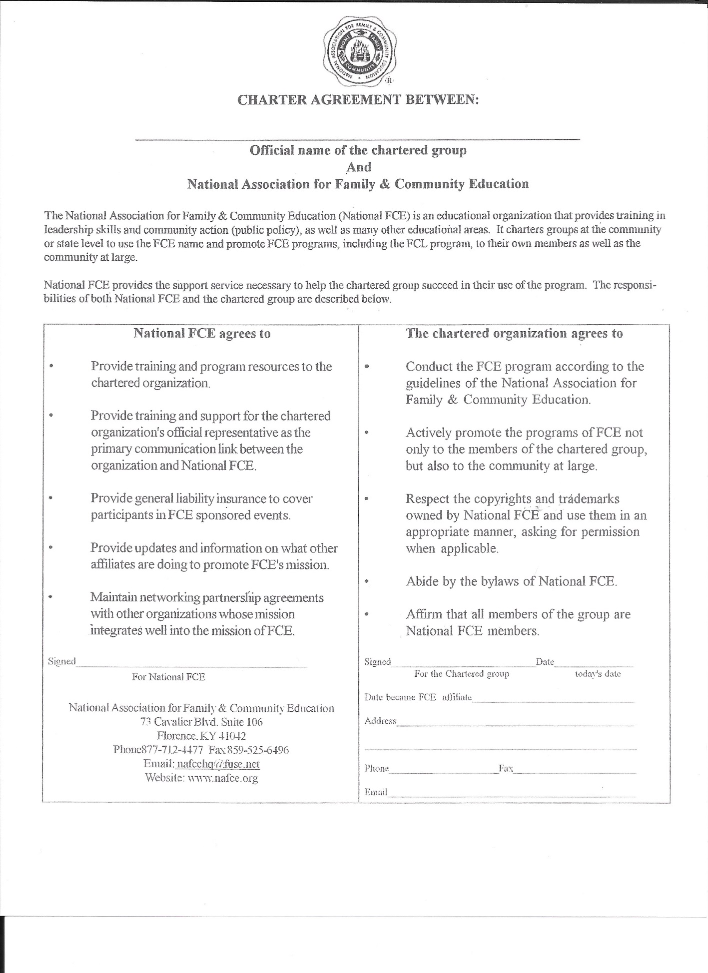
Notes:
The Charter ~ again the address will be updated

Slide 25
HONORARY MEMBER AWARD
The Honorary Member Award is given to an individual selected by a unanimous vote of the Board of Directors for lifetime membership because of their dedicated efforts on behalf of FCE. The Honorary Membership carries with it all privileges of membership except the power to vote. Dues shall be waived.
Notes:
The National FCE Board can recognize someone as an Honorary Member by vote. A list of Honorary members is on the website.

Slide 26
SAMPLE of FCE CHALLENGE
FORM
State: ________________________________
Person Reporting: ______________________
Target Date: ___________________________
Target Audience: _______________________
Materials used: _________________________
__________________________
__________________________
__________________________
__________________________
Follow-up Meeting Date: _________________
How was the material used: _________________________________________________________________
Final results: ______________________________________________________________________________

Slide 27
Sample of FCE Challenge
A. The Marketing/Promotions Committee was charged with recommending ways to promote FCE products/ materials and market FCE. The marketing committee met with the membership committee at the 2006 fall board meeting, brainstormed and proposed several ideas to the board. One of the ideas was a sample packet of materials and products to be given to other organizations and individuals. This can be a viable way to “market” FCE to different target audiences. For instance: A. Young Families: include the Hearth Fire lesson on “Kitchen Concoctions,” any of the “Media” Hearth Fires, an FCE Friends storybook and stuffed animal, a membership brochure, a letter introducing FCE, a list of available materials, and Headquarters information.
B. Parent Teacher Associations/Parent Patron Associations: include all of the “Media” Hearth Fire lessons and perhaps the Hearth Fire “Recruiting and Keeping Members,” and, of course, the letter introducing our organization, membership brochure, list of materials, and Headquarters information.
C. Pre Schools/Day Care Centers: include FCE Friends/Puppets, FCE Friends Storybooks to coincide with the FCE Friends, Hearth Fire “Someone’s in the Kitchen Making Concoctions,” “Kids for Character” video, information on the “Books for Newborns” project conducted in the local area. Also include a letter introducing the organization, membership brochures and forms. Any other information about local child oriented programs sponsored by the local FCE groups.
D. Organizations similar to Rotary Clubs, American Association of University Women, local Chamber of Commerce and Quota Clubs: Include Hearth Fires such as “Board Service: Leadership in Action,” “The Care and Feeding of Group Members,” and “True Leadership.” Also include information on other materials available with an offer to bring programs such as “The Deadly Triangle of Violence” to their groups. Make sure to include membership brochures and forms, information on the organization, and National and local contact information.
E. National FCE is offering this as a challenge to the state organizations, and of course with the challenge to participate comes the incentive that there will be a PRIZE!! Each state that participates in the “Sample FCE” challenge, fills out the report form, and mails it to the board chairman, by the deadline established, will be judged by the other state presidents. The one chosen to be the winner will receive a gift certificate valued at $100.00 to be redeemed for National FCE materials.

Slide 28
NATIONAL FCE SCHOLARSHIP FORM
Summary for: Year________ State_________________
Due Date: Postmarked April 15
Send one copy to: National FCE Headquarters 73 Cavalier Blvd. Suite 106 Florence, KY 41042
Name of person submitting: ______________________
Address: ___________________________________________________________
City, State, Zip Code_____________________________________________
Phone: ____________________
Email:_______________________________
Number of scholarships to FCE Members: ________
2. Dollar amount of scholarships given to members: $______________
3. Number of scholarships to non-FCE Members: ________
4. Dollar amount of scholarships given to non-members: $______________
TOTAL OF ALL SCHOLARSHIP/DONATION MONEY GIVEN: $_____________
Notes:
This form is for states to report money they give to others as donations or scholarships. It helps National FCE tell our story of helping people.

Slide 29
NATIONAL FCE 20_­­­_­­­­_ STATE OFFICERS’ WEB SITE INFORMATION UPDATE
Please complete this form and return immediately after State Officer Elections (or by January 1, 20____ at the latest) to
National FCE Headquarters, 73 Cavalier Blvd., Ste. 106, Florence, KY 41042
PLEASE TYPE OR PRINT CLEARLY State: _________________________
PRESIDENT:
Name:________
Mailing Address:
City/State/Zip:
Phone: _____ ____________
Email: ____________________
Date Term Expires:
PRESIDENT-ELECT (when applicable):
Name: ______ ____________
Mailing Address:
City/State/Zip:
Phone: ___ ____________
Email: ____ ____________
Date Term Expires:
Notes:
State FCEs send their current list of officers to Headquarters and/or the webmaster. The date is January 1 but as soon after your elections the form will be appreciated. Again the address will be updated after April 30.

Slide 30
VICE PRESIDENT FOR PROGRAM:
Name: _______ _____________
Mailing Address:
City/State/Zip: _____________
Phone: _______
Email: _______ _____________
Date Term Expires:
VICE PRESIDENT FOR PUBLIC POLICY AND/OR FCL CONTACT:
Name: _______________________________________
Mailing Address: _____________
City/State/Zip: _____________
Phone: ____________________________________________________
Email: _______________________________________
Date Term Expires:
SECRETARY:
Name: _____________
Mailing Address:
City/State/Zip: _____________
Phone: _____________
Email: _____________
Date Term Expires:
TREASURER:
Name: ____________
Mailing Address:
City/State/Zip: _____________
Phone: _____________
Email: _______________________________________
Date Term Expires:

Slide 31
State Web Site: www.
Date of Your 20____ State Meeting (location):
Do you have a signed license agreement with National? Yes _____ No _____
PLEASE RECHECK FOR ACCURACY
KEEP A COPY FOR YOUR RECORDS
SEND COMPLETED FORM TO HEADQUARTERS
Notes:
The state may request that the information not be listed. BUT your information is out there ~ we have all received requests from the National President, State President and other officers requesting money. Those are all scams. All FCE money comes from or to the State or National Treasurer and they will not be sending emails requesting funds or help in paying an invoice.

